Slide 1
Strings

Slide 2
Agenda
C-String
String C++ Class

Slide 3
C-String

Slide 4
Types of array declaration
It’s simply an array of char
char str[80]; // string of 79 char.
char str[] = “Farewell! art”;
char str[] = { ‘M’, ‘y’, ‘ ‘, ‘I’, ‘D’};

Slide 5
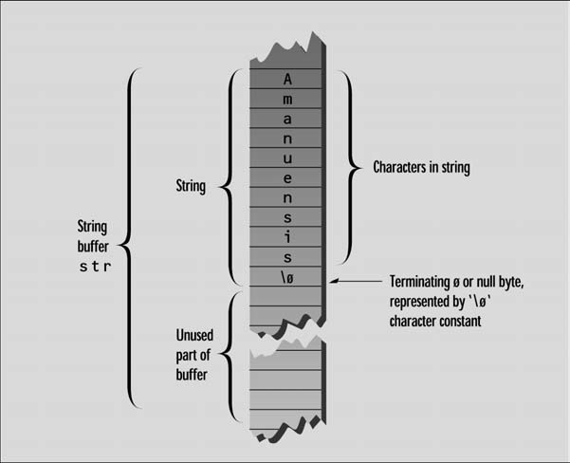
NULL Character

Slide 6
cin & cout a c-string
cin >> str; // space or end of line terminator
cin.get(str, MAX_SIZE);
cin.get(str, MAX_SIZE, ‘$’); // terminate with ‘$’
cout << str;

Slide 7
Copying a String
#include <cstring> //for strlen()
int main() { //initialized string
char str1[] = “Oh, Captain, my Captain! our fearful trip is done”;
const int MAX = 80; //size of str2
char str2[MAX]; //empty string
int n = strlen(str1), j;
for(j=0; j<n; j++)
str2[j] = str1[j]; // from str1 to str2
str2[j] = ‘\0’; //insert NULL at end
cout << str2 << endl; //display str2
return 0;
}

Slide 8
Arrays of Strings
#include <iostream>
using namespace std;
int main() {
const int DAYS = 7; //number of strings in array
const int MAX = 10; //maximum size of each string
char star[DAYS][MAX] = { “Sunday”, “Monday”, “Tuesday”, “Wednesday”, “Thursday”, “Friday”, “Saturday” }; //array of strings
for(int j=0; j<DAYS; j++) //display every string
cout << star[j] << endl;
return 0;
}

Slide 9
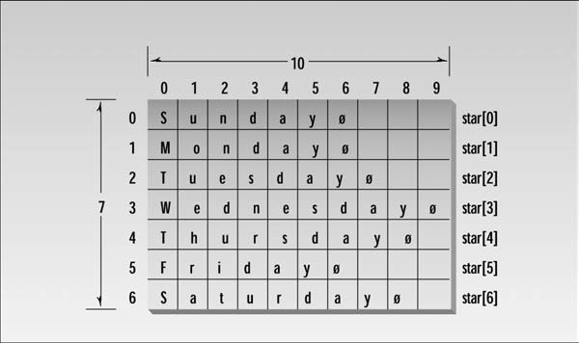
Arrays of Strings

Slide 10
String C++ class

Slide 11
String C++ class
Standard C++ includes a new class called string. This class improves on the traditional C-string in many ways.
No need to worry about the size and memory management
More flexibility and functionality. Such as concatenating two string with plus sign (s3=s1+s2)
More efficient and safer to use than C-strings
In most situations it is the preferred approach

Slide 12
String C++ class
To include:
#include <string>
To Define:
string s1(“Man”);
string s2 = “Beast”;
string s3;
string s4(3,’a’); // aaa
To Assign:
s3 = s1;
To concatenate:
s3 = “Neither “ + s1 + “ nor “;

Slide 13
String C++ class
cin:
cin >> s; //terminated by spaces or end of line
getline (cin, s); //terminated by end of line
getline (cin, s, ’$’); //multiple lines
cout:
cout << s;
Access a char:
cin >> s[5];
s[3] = ’c’;
Access a char (exception if out-of-bounds):
cin >> s.at(5);
s.at(5) = ’c’;

Slide 14
String C++ class
length:
s.length(); OR s.size();
check if it’s empty:
s.empty();
clear a string:
s.clear(); OR s=””;
First char:
s.front();
Last char:
s.back();

Slide 15
String C++ class
Append a char:
s.push_back(‘e’);
Remove a char from the end:
s.pop_back();
To append a string:
s1 += s2; OR s1.append(s2);
Reverse a string:
reverse(s.begin(), s.end());
Generate a substring:
s2=s1.substr(5,3); //(startIndex, Len)
Check if two strings are the same:
if(s1==s2){}

Slide 16
String C++ class
Erase from a string:
string s=”Ali Khaled”;
s.erase(2,4); // (startIndex, Len)
cout<<s; // “Alaled”
Insert in a string:
string s=”Alaled”;
s.insert(2,”i Kh”); // (startIndex, string)
cout<<s; // “Ali Khaled”
Replace in a string:
string s=”Ali Khaled”;
s.replace(0,3,”Noha”);
// (startIndex, Len to be erased, String to be inserted)
cout<<s; // “Noha Khaled”

Slide 17
String C++ class
Find first occurrence of string in a string:
string s="Ali Khaled al-naggar";
int index=s.find("al");
if(index==string::npos)
cout<<"Not found\n";
else
cout<<index<<'\n'; // 6
For more about strings and its functions description: string - C++ Ref

Slide 18
To Solve
Way Too Long Words
Palindrome with leading zeros

